Slide 2
Centered in
What does mean to you?
value
AVIATION SERVICES
Planning
Design & Construction
Air Service Development
GIS/Asset Management
Environmental
Airside Development
Landside Development

Slide 3
Centered in
value
LEARN MORE
Mike Reiter, PE
Aviation Group Manager, Southeast Region & Atlanta Office Manager
404.915.4440
mreiter@cmtengr.com
AVIATION SERVICES
www.cmtengr.com
Planning
Design & Construction
Air Service Development
GIS/Asset Management
Environmental
Airside Development
Landside Development
Land/Easement Acquisition

Slide 4
LEARN MORE
Mike Reiter, PE
Aviation Group Manager, Southeast Region & Atlanta Office Manager
404.915.4440
mreiter@cmtengr.com
www.cmtengr.com

Slide 6
CROY ENGINEERING

Slide 7
OUR SERVICES
Construction Administration
Landscape
Architecture
Municipal Development
Municipal Utilities
Parks and Recreation
Land
Acquisition
Aviation
Program
Management
Site
Development
Planning
Surveying
Traffic Mobility
Transit
Transportation

Slide 8
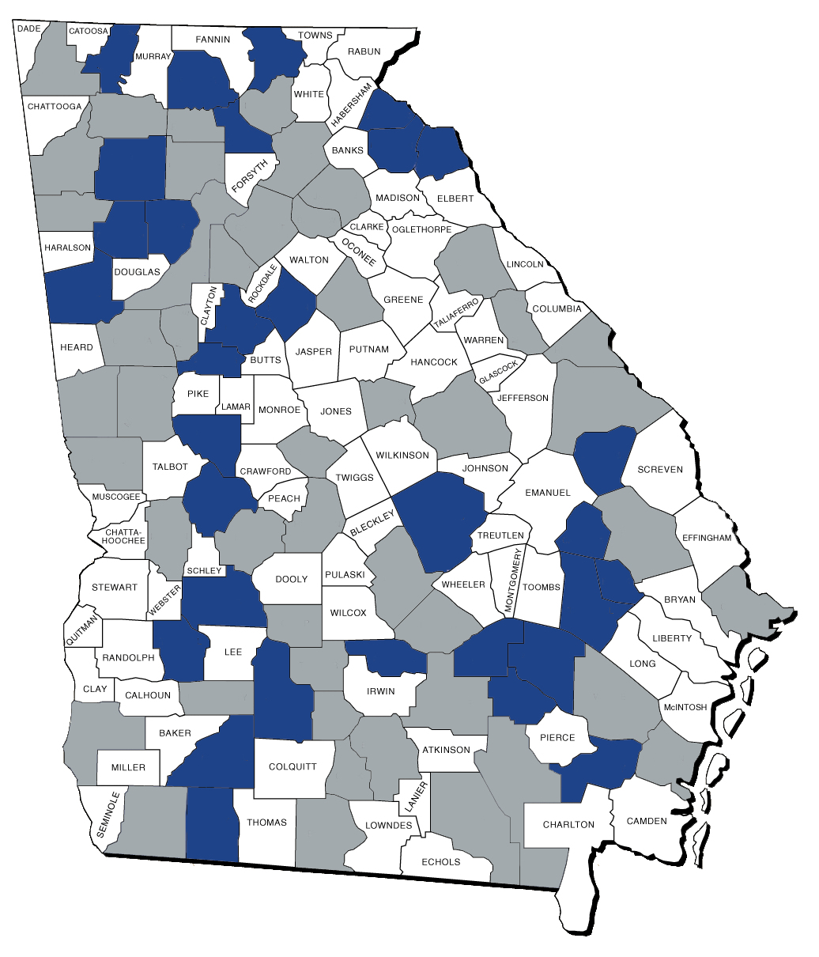
OUR AVIATION EXPERIENCE
BY THE NUMBERS

Slide 9
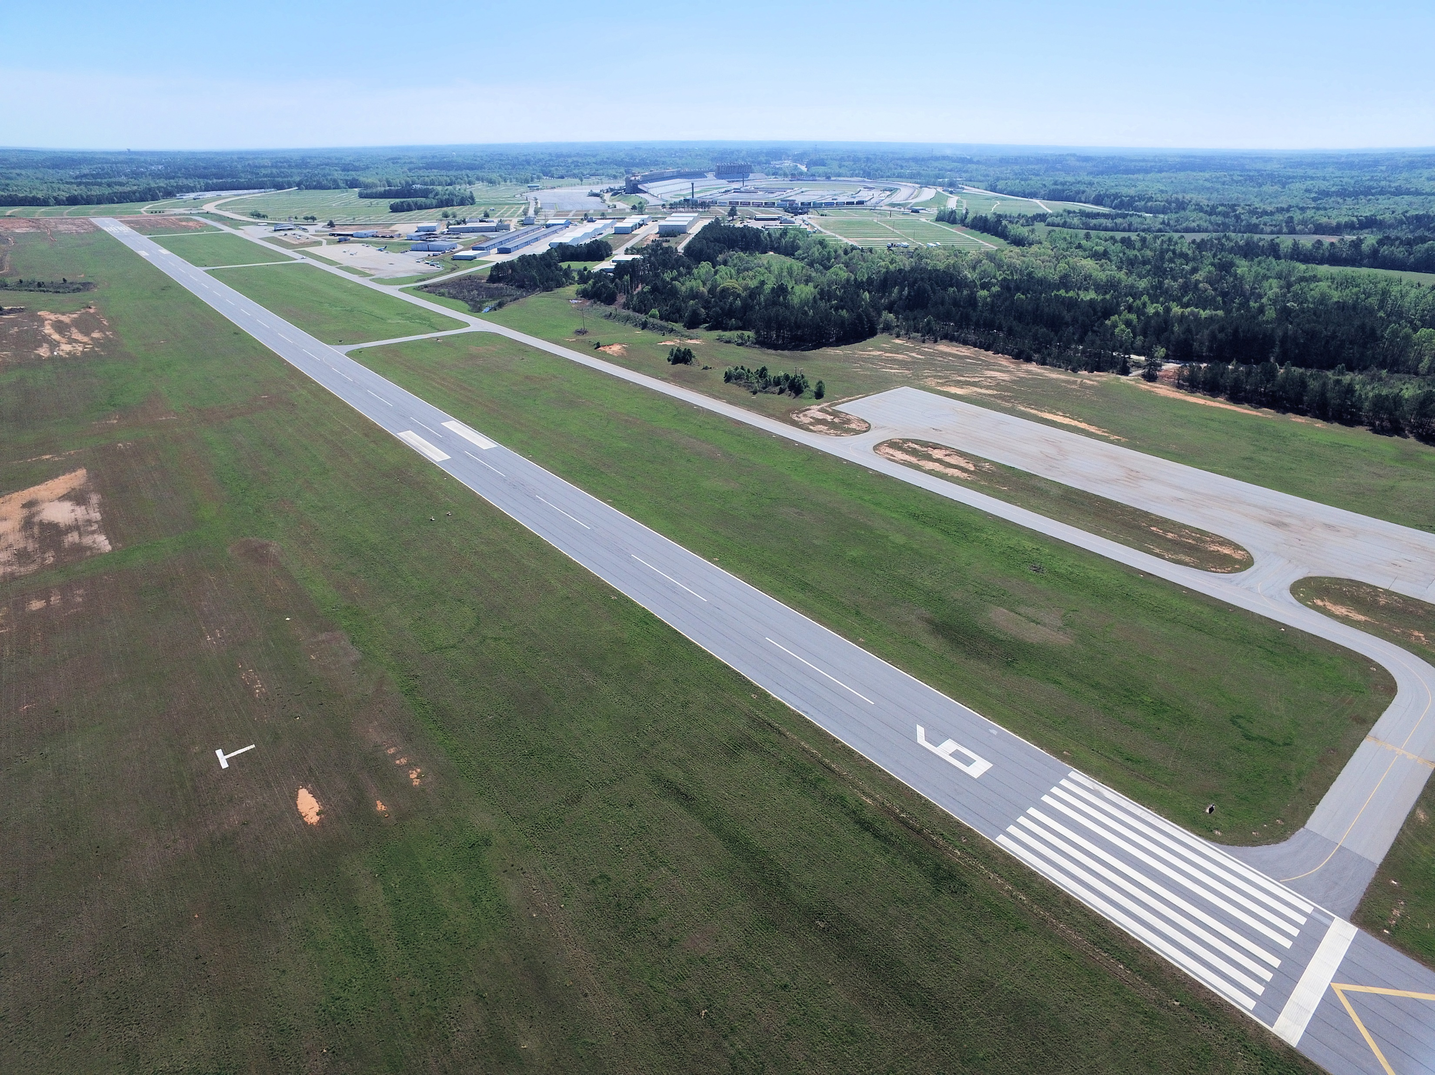
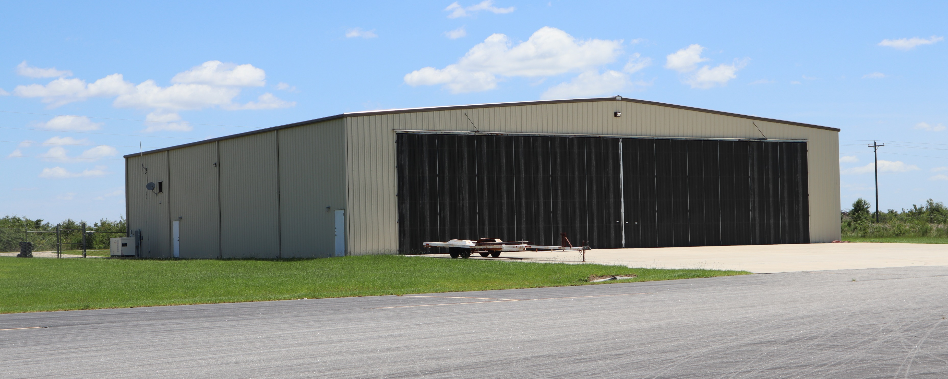
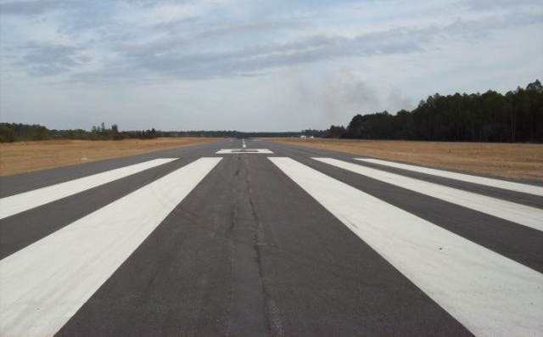
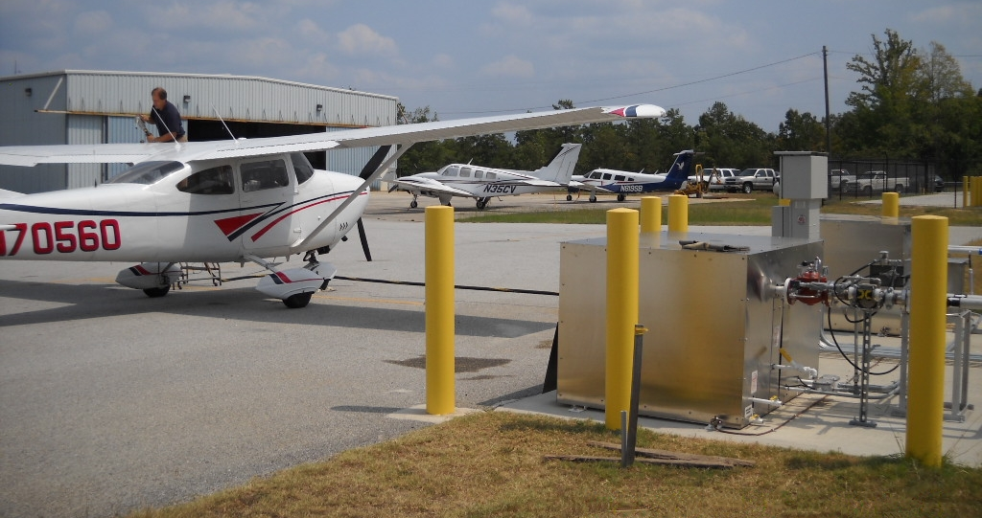
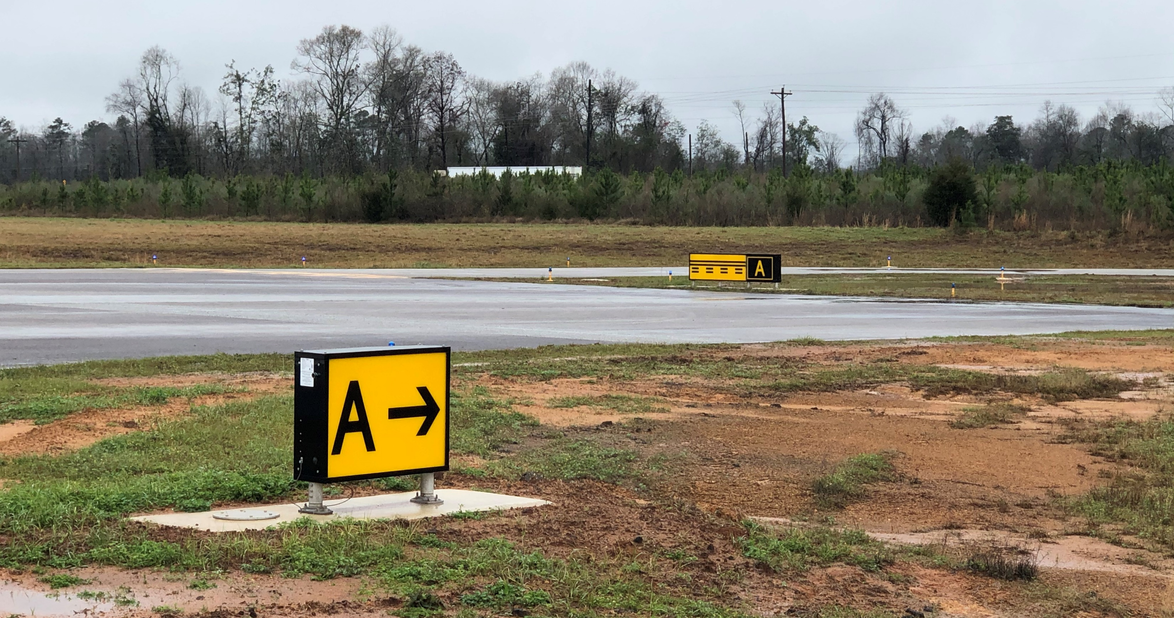
OUR AVIATION EXPERIENCE
Reidsville Airport
Henry County Airport
Baxley Airport
Toccoa Airport

