Slide 1
Session 4
FBO / Airport Relationships
Tim Obitts, National Air Transportation Association
2021 GAA Annual Conference & Expo | St. Simons Island, GA | Sept 29 – Oct 1

Slide 2
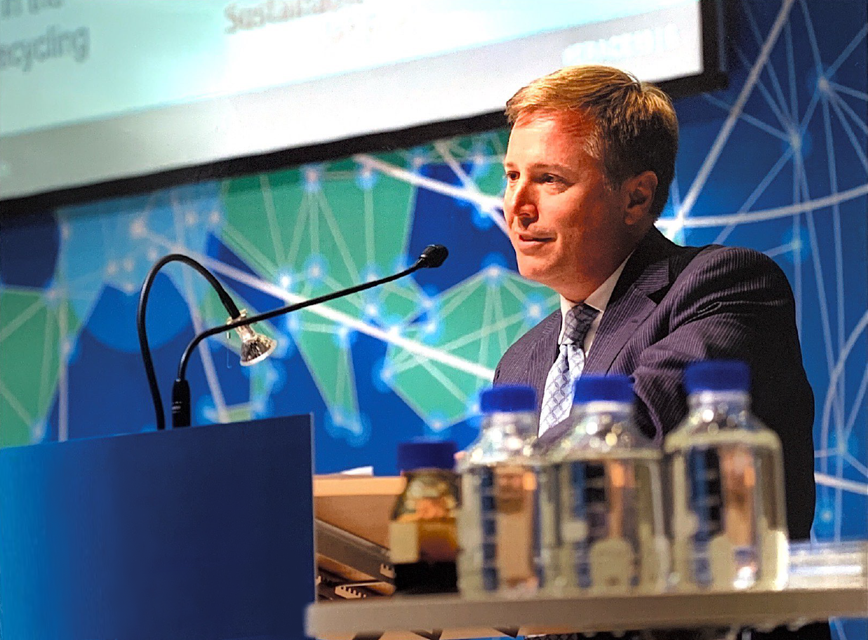
FBO / Airport Relationships & The Environment

Slide 3
About NATA
Has served the interests of the general aviation business community for more than 80 years
Represents over 3,700 businesses including FBOs, part 135 operators, fractionals, MROs, repair stations, and training providers
NATA’s mission is to help its members win in the marketplace
Safety 1st suite of products
Workers Compensation Insurance Program
Loss of License Insurance Program for Part 135/91
Member driven advocacy reflecting our companies’ lines of business
Airport Business Committee
Air Charter Committee
Aircraft Maintenance Committee
Safety Committee
Workforce Development Committee
Aircraft Management Committee

Slide 4
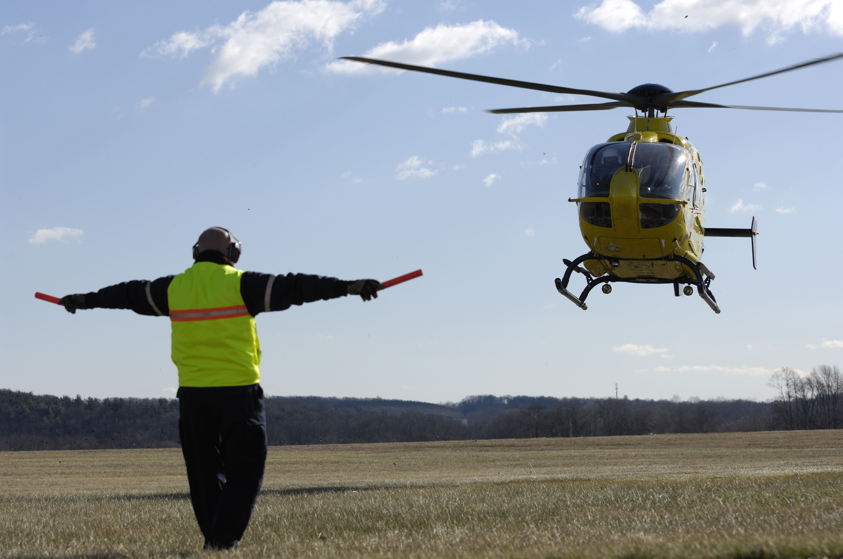
Airport Sponsor Challenges
Financial self-sustainability, while striving to support and preserve the valuable services and jobs that the business aviation industry provides to their communities and address environmental pressures facing the airport (pollution and noise).

Slide 5
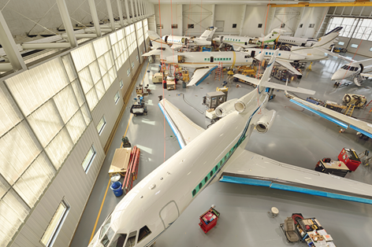
Win-Win-Win
Creating an environment where airport businesses can thrive provides benefits to airport sponsors, users, and operators, while creating high-skilled, high-paying jobs in the community.

Slide 6
A Business-Friendly Environment
Attracts public-private partnerships to the airport, including those that advance green technology and neighborhood compatibility.

Slide 7
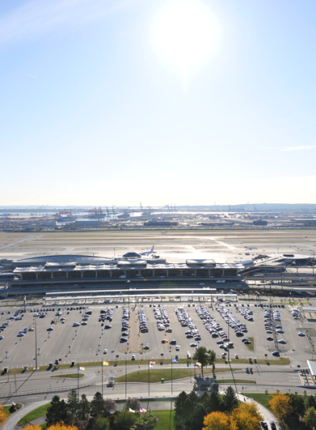
Benefits of Aeronautical Service Providers
Long-term business partners
Cost-effective, high-quality range of services
Shield from direct exposure to market volatility
Draw new users to the airport

Slide 8
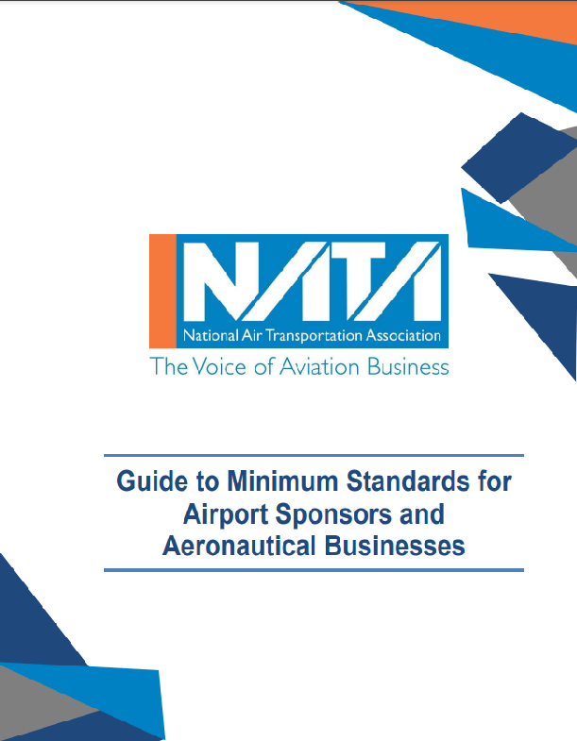
Collaboration
Between airport sponsors and commercial aeronautical tenants maximizes opportunities and helps address challenges
One way is developing and adhering to minimum standards

Slide 9
Minimum Standards Overview
Level the playing field for airport businesses and helps comply with Grant Assurances
Provide a means for an airport to raise the level of safety in their FBO operations
Ensure that a certain type, level, and quality of commercial aeronautical activities and services are available to airport users

Slide 10
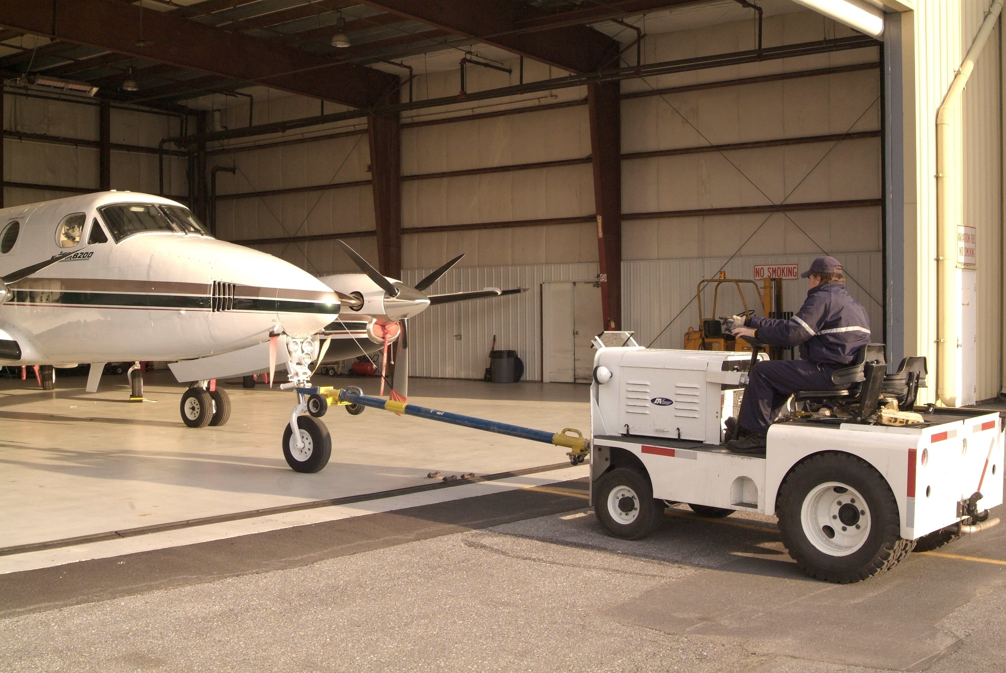
Minimum Standards Overview – Cont.
Create a safer operating environment.
Guarantee higher quality services to the public.
Protect the airport by ensuring service providers maintain a minimum level of training, equipment, staffing, and insurance coverage.

Slide 11
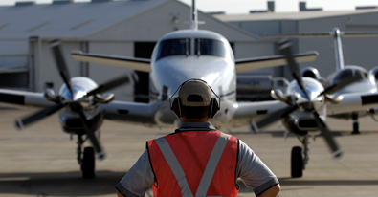
Minimum Standards Benefits to
Aeronautical Service Providers
Protect against devaluation of current investments and allow potential aeronautical service providers to accurately predict initial investment
Allow a more thorough business plan to be developed
Reduce the risk of airports violating grant assurances

Slide 12
Grant Assurance 22 –
Economic Nondiscrimination
Public-use airport sponsors monitor the pricing of aeronautical services under the requirements of FAA Grant Assurance 22
To furnish services on a “reasonable, and not unjustly discriminatory, basis to all users thereof”

Slide 13
Grant Assurance 23 – Exclusive Rights
Will permit no exclusive right for the use of the airport by any person providing, or intending to provide, aeronautical services to the public.
GAO Study (2021)

Slide 14
Grant Assurance 24 – Fee and Rental Structure
An airport sponsor at a federally obligated airport will maintain a fee and rental structure for the facilities and services at the airport which will make the airport as self-sustaining as possible under the airport’s existing circumstances.

Slide 15
Setting Minimum Standards - Recap
Airport minimum standards help promote the highest levels of safety, security, and service for all airport users.
All stakeholders should be involved in the minimum standards process at airports because it sets the playing field for private enterprise.
NATA has a resource to assist with setting minimum standards.

Slide 16
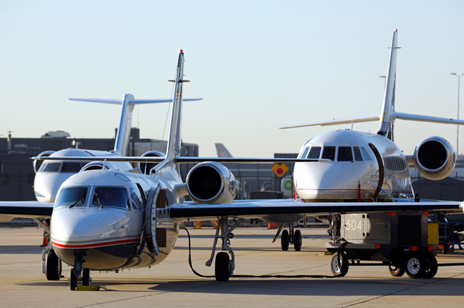
Not All Operating Environments are Alike
Local communities, airport sponsors, and tenant businesses should work together to determine what may be right for the specific airport community.

Slide 17
Working Together on Environmental Issues
100ll problems, is there a solution?
Sustainable Aviation Fuel (SAF)
Noise: (Airport Noise and Capacity Act of 1990 and the next FAA Reauthorization)

Slide 18
What is Sustainable Aviation Fuel (SAF)?
SAF is a low-carbon synthetic jet fuel derived from biomass or other sustainable feedstocks, including wastes and residues, cellulosic feedstocks, waste steel mill gases, and captured CO2.
SAF reduces lifecycle greenhouse gas emissions by up to 80% compared to conventional jet fuel. Coupled with CCS and other technologies or practices, emissions can be negative.
SAF is a drop-in fuel that is compatible with existing aircraft and fuel delivery infrastructure.
7 SAF pathways currently certified under ASTM D7566 for use in conventional aircraft.
SAF has significant public health benefits, reducing particulate matter emissions by 80% and nearly eliminating sulfur emissions.
SAF is commercially available today in limited quantities, but significant scale is possible with appropriate policies.

Slide 19
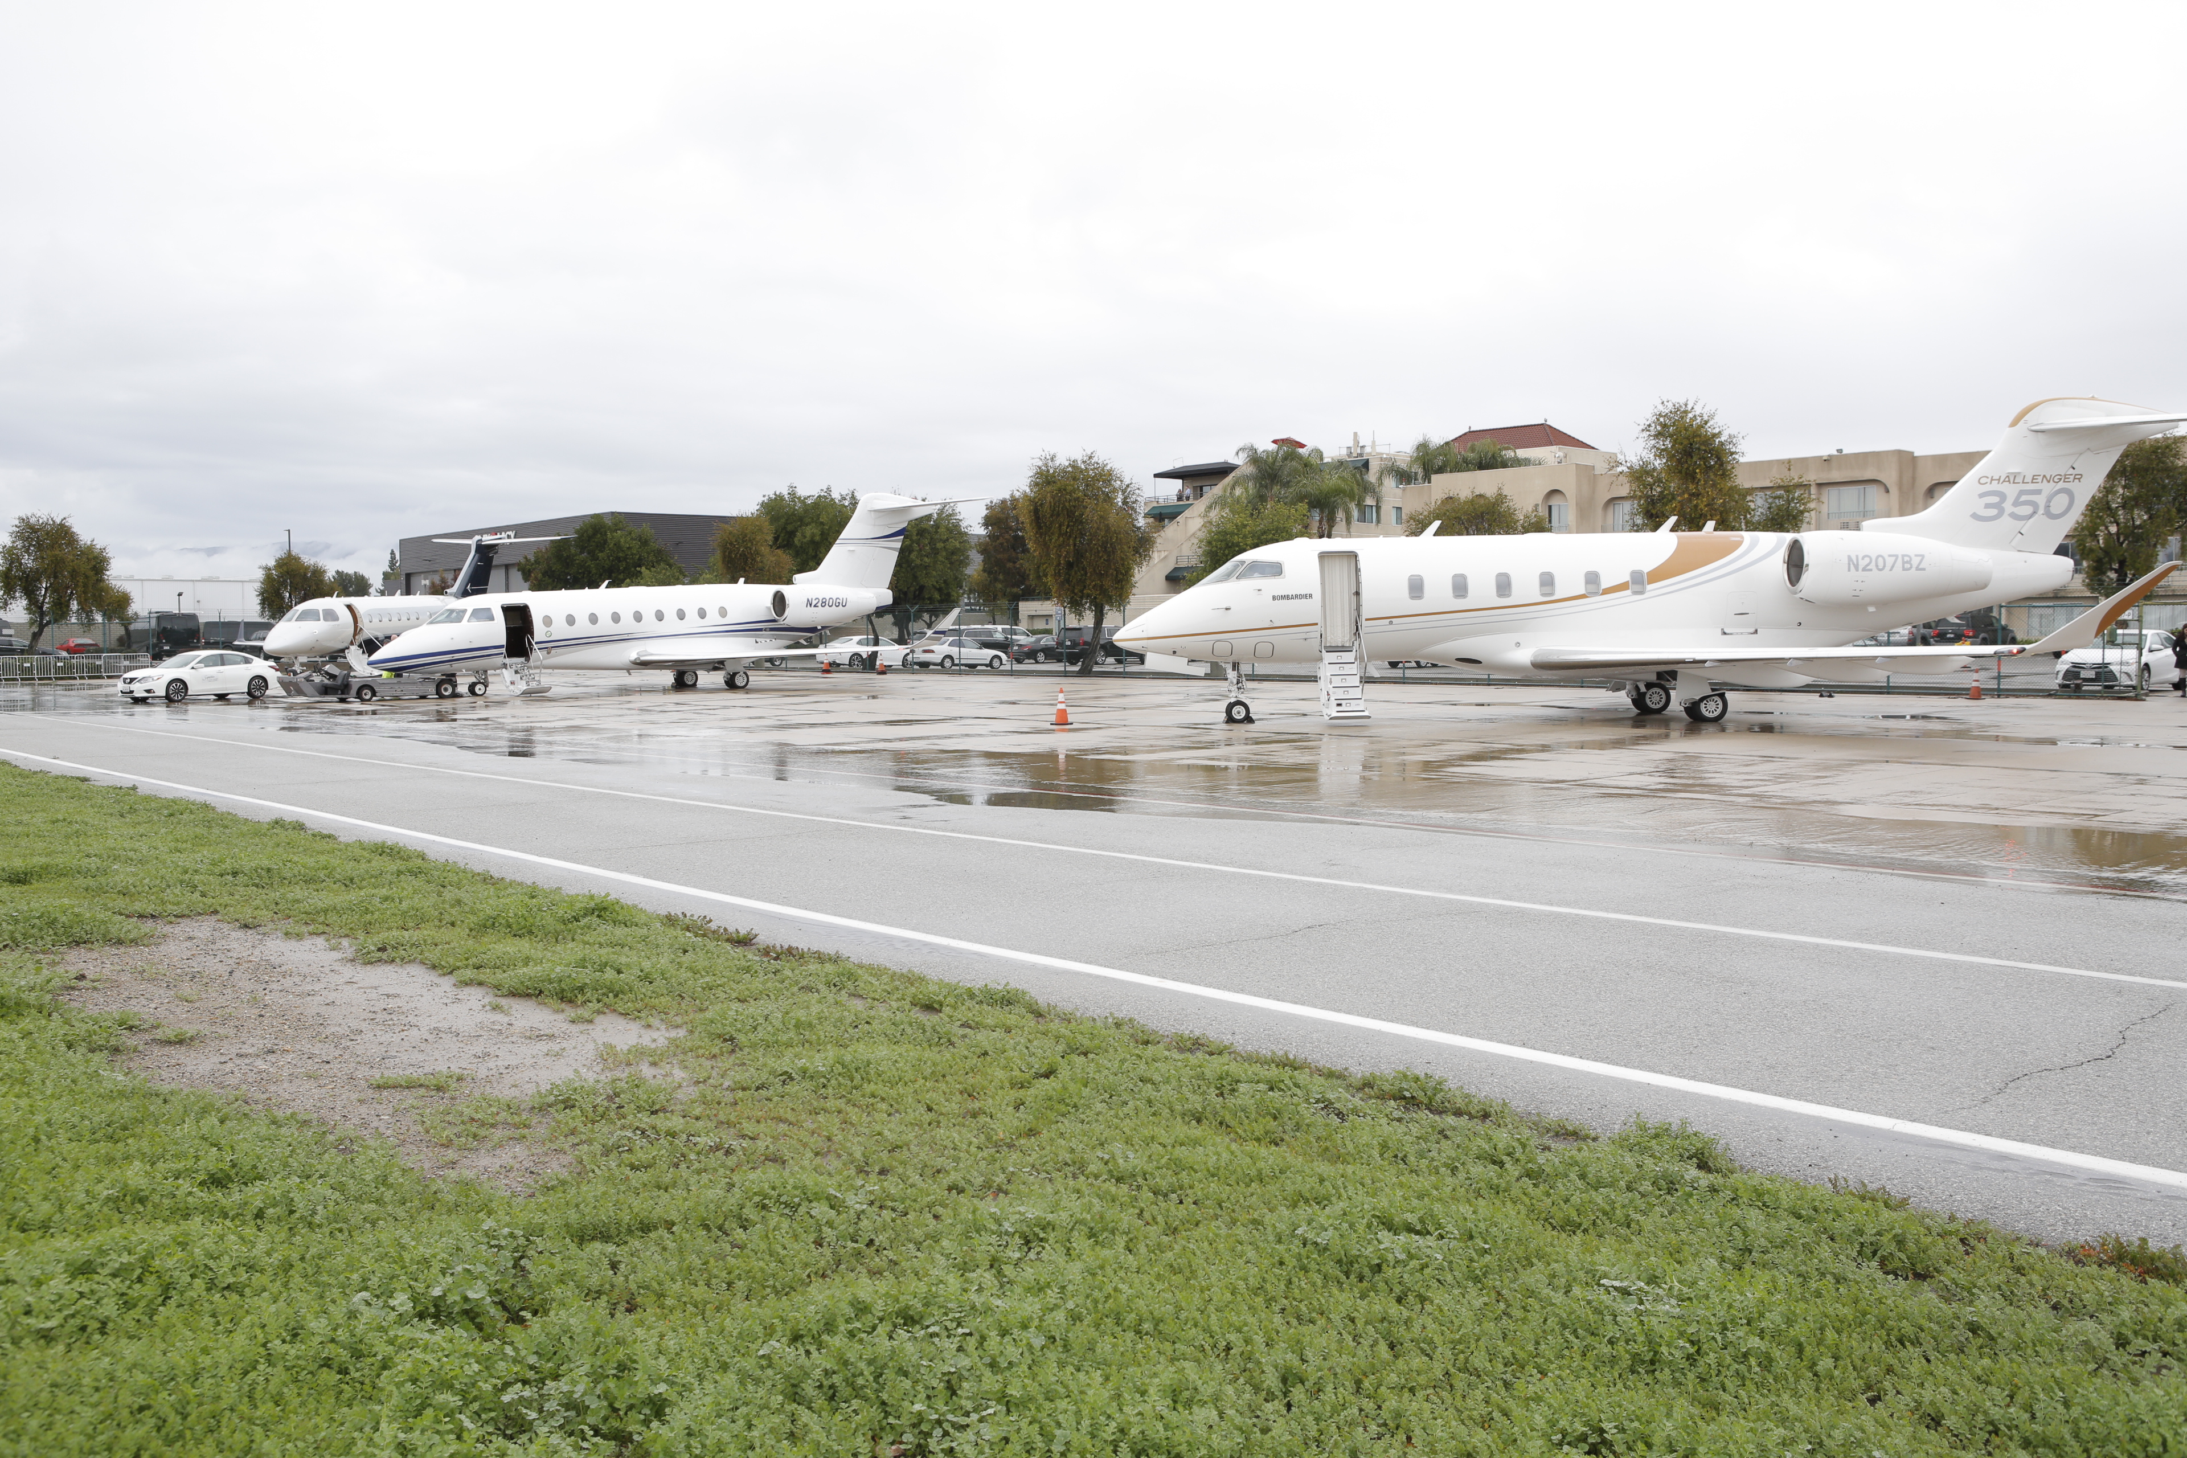
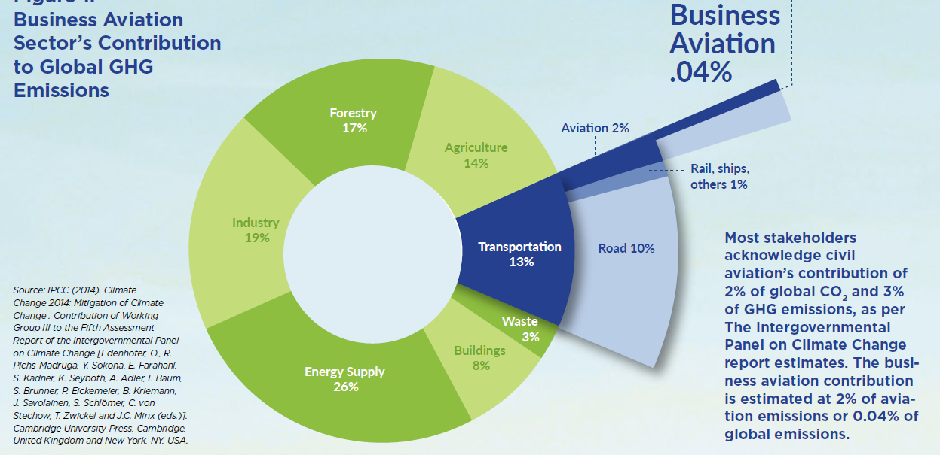
Business Aviation’s Contribution to Global GHG Emissions

Slide 20
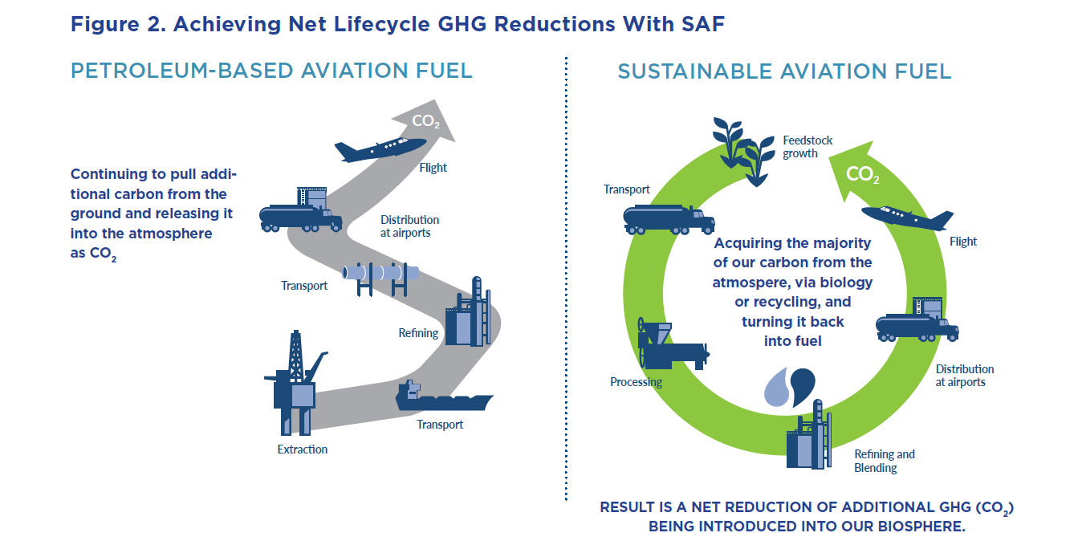
Achieving Net Lifecycle GHG Reductions with SAF

Slide 21
Better Together
Open communication and participation among all parties involved are the keys to success
Working together on solutions for problems facing the airport
It’s not an “us vs. them” situation. It’s a “we.”

Slide 22
Contact
Timothy Obitts
President & CEO
National Air Transportation Association
TObitts@nata.aero
(703) 678-5833
www.nata.aero

